Slide 1



Session // 01 INTRODUCTION TO PYTORCH FACULTY OF SCIENCE AND ENGINEERING +++
Diego Corona Lopez – AI Technical Specialist

Slide 2

Agenda
PyTorch fundamentals and advantages
Working with tensors
Tensor operations and manipulation
Automatic differentiation (Autograd)
Moving from data to tensors
GPU acceleration

Slide 3

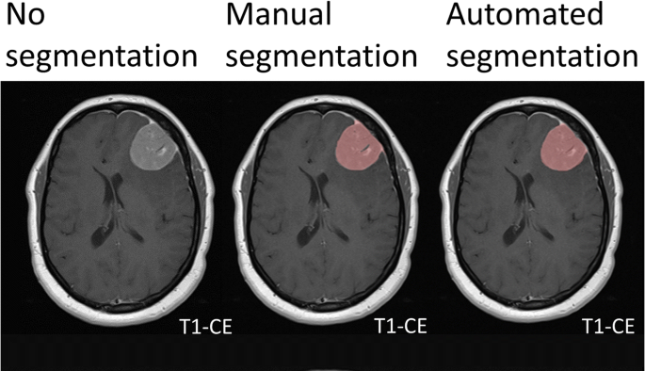
Introduction
Deep Learning is a subset of machine learning where models — typically neural networks — learn directly from data.Inspired by the structure and function of the human brain. Just like humans learn to recognize cats by seeing many pictures of cats, deep learning models learn patterns from data — not rules programmed by hand.

Slide 4
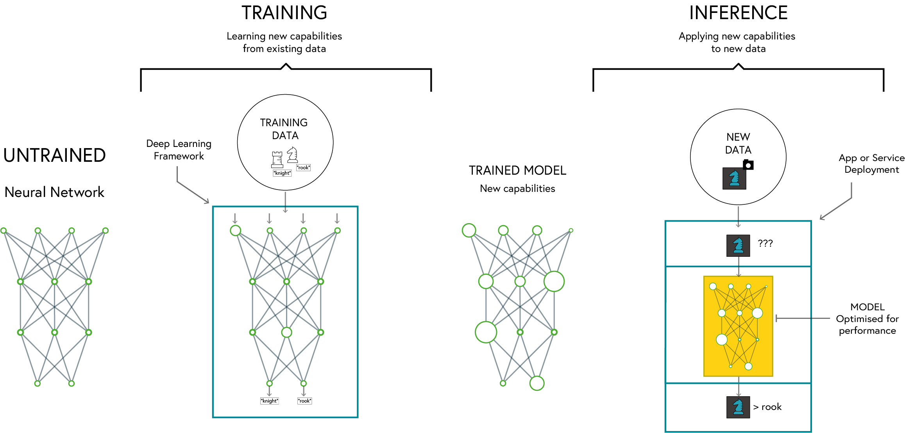
Deep learning

Slide 5

PyTorch
Dynamic Computation Graph: Easier debugging and flexible model building
Pythonic and Intuitive API: Seamless integration with Python libraries
Strong Research and Industry Adoption: Used by major companies and researchers
Excellent GPU Acceleration: Optimised for performance on GPUs and TPUs
SE01
04

Slide 6
Why PYTORCH
Feature | PyTorch | TensorFlow | Keras
Ease of Use | High (Pythonic, dynamic computation graph) | Moderate (Static graph by default, more setup) | Very High (High-level API)
Flexibility | High | Moderate | Low (abstracted API)
Performance | High | Very High (Optimized for deployment) | Moderate
Debugging | Easy (Eager execution) | Harder (Graph-based execution) | Easy
GPU Support | Excellent | Excellent | Good
Industry Use | Research, Prototyping | Production, Deployment | Rapid Prototyping

Slide 7
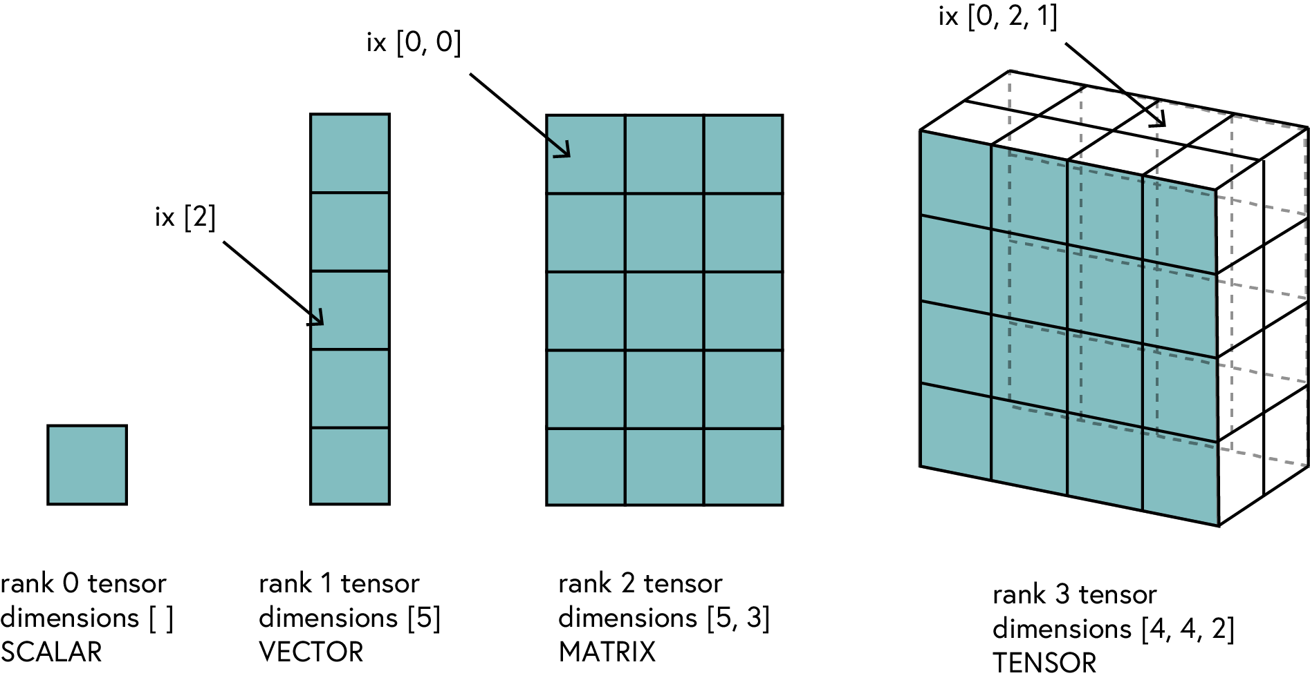
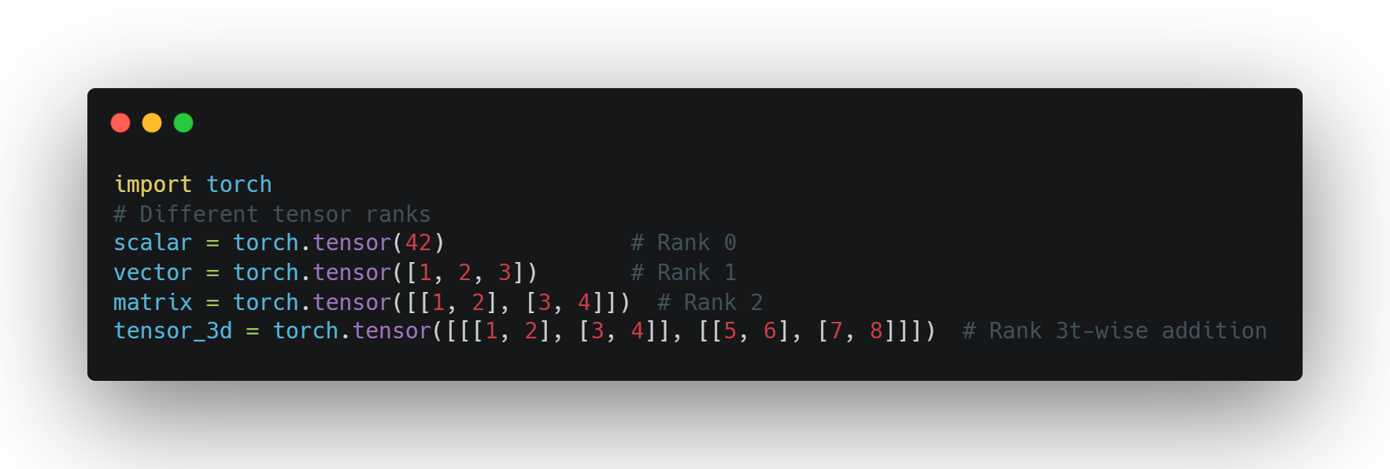
Tensors
Definition: A generalization of vectors and matrices to higher dimensions
Why Tensors?
Efficient representation of multi-dimensional data
Optimized for computation (CPU & GPU)
SE01
07

Slide 8
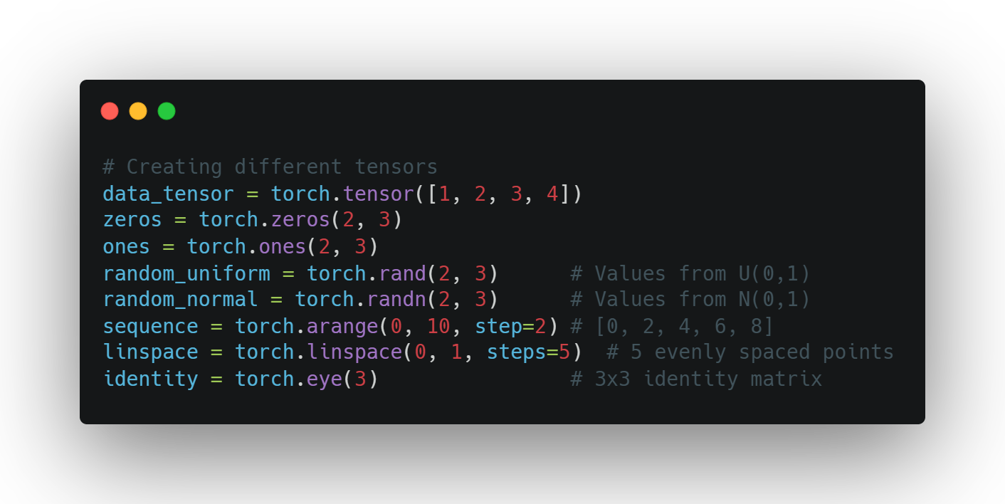
Creating Tensors
Basic Tensor Creation Methods
torch.tensor() - from existing data
torch.zeros(), torch.ones() - filled tensors
torch.rand(), torch.randn() - random tensors
torch.arange(), torch.linspace() - sequences
torch.eye() - identity matrices
Data types can be specified with dtype parameter
SE01
07

Slide 9
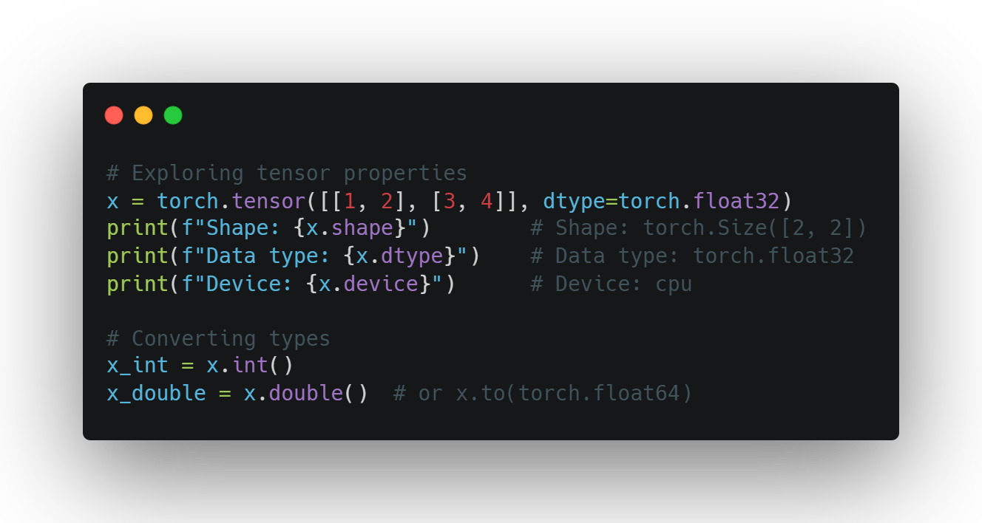
TENSOR
PROPERTIES
Working with Tensor Attributes
Shape: tensor.shape
Data type: tensor.dtype
Device: tensor.device
Accessing values: tensor.item() for scalars
Converting types: tensor.float(), tensor.int()
SE01
07

Slide 10
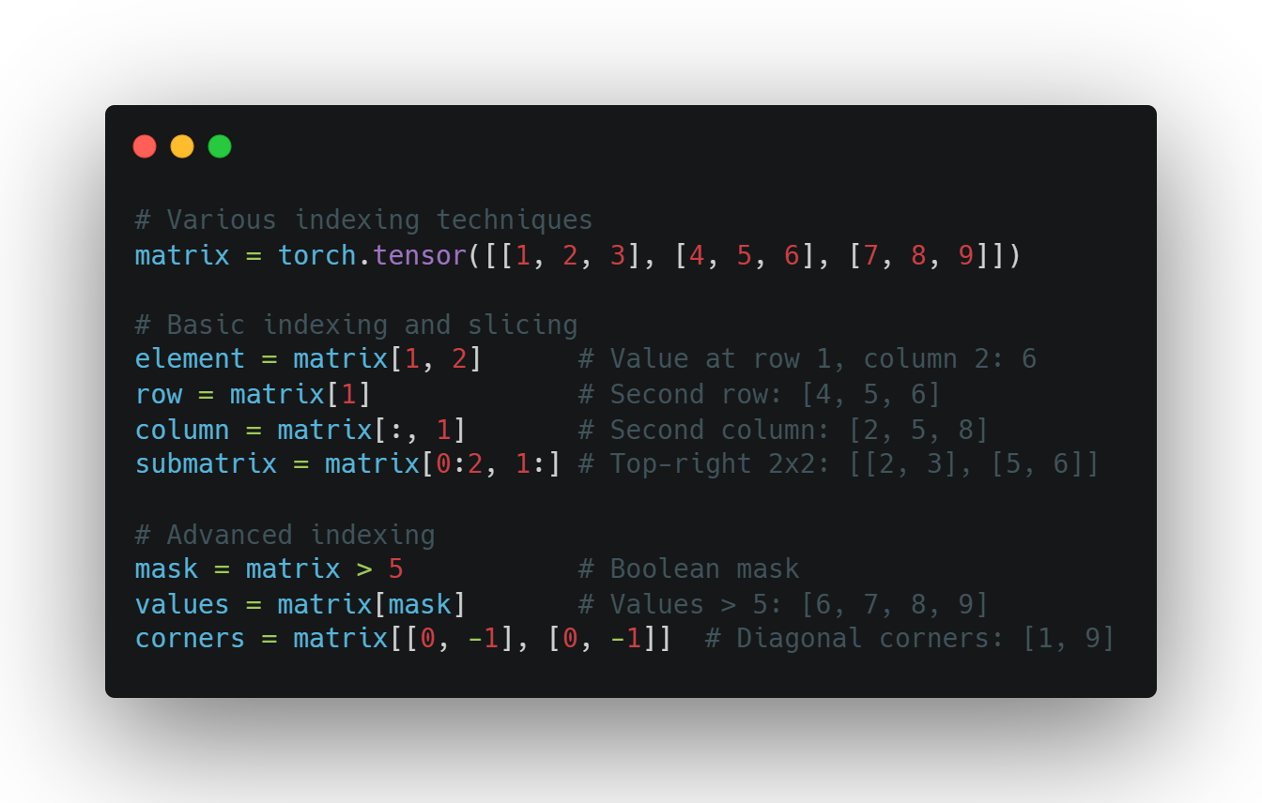
TENSOR
indexing
Accessing Tensor Data
Basic indexing: tensor[i, j]
Slicing: tensor[1:3]
Advanced indexing techniques:
Boolean masks: tensor[tensor > 0]
Negative indexing: tensor[-1] (last element)
Using ellipsis: tensor[..., 0]
SE01
07

Slide 11
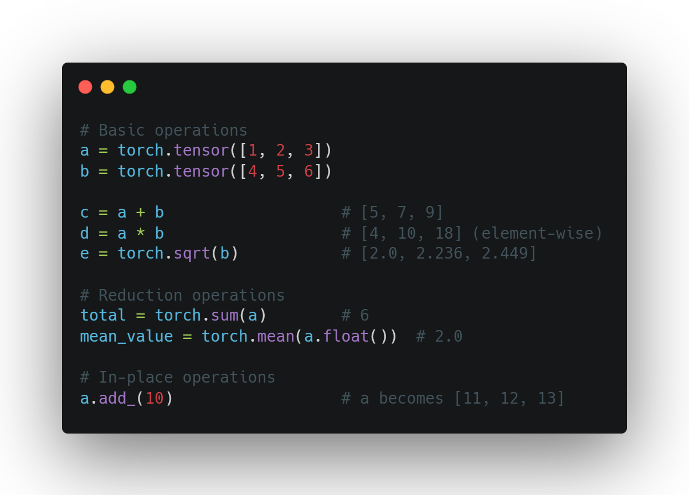
BASIC TENSOR
OPERATIONS
Common Operations
Arithmetic: +, -, *, /
Element-wise operations: torch.sqrt(), torch.pow()
Reduction: torch.sum(), torch.mean()
Comparisons: >, <, ==
In-place operations: tensor.add_(1) (note the underscore)
SE01
07

Slide 12
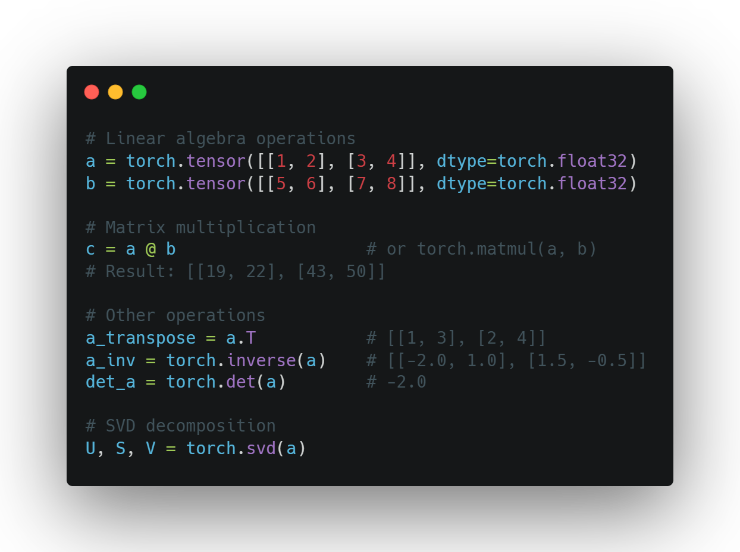
MATRIX
OPERATIONS
Linear Algebra with PyTorch
Matrix multiplication: @ or torch.matmul()
Transposition: .T or torch.transpose()
Inverse: torch.inverse()
Determinant: torch.det()
Eigenvalues: torch.eig()
SVD: torch.svd()
SE01
07

Slide 13
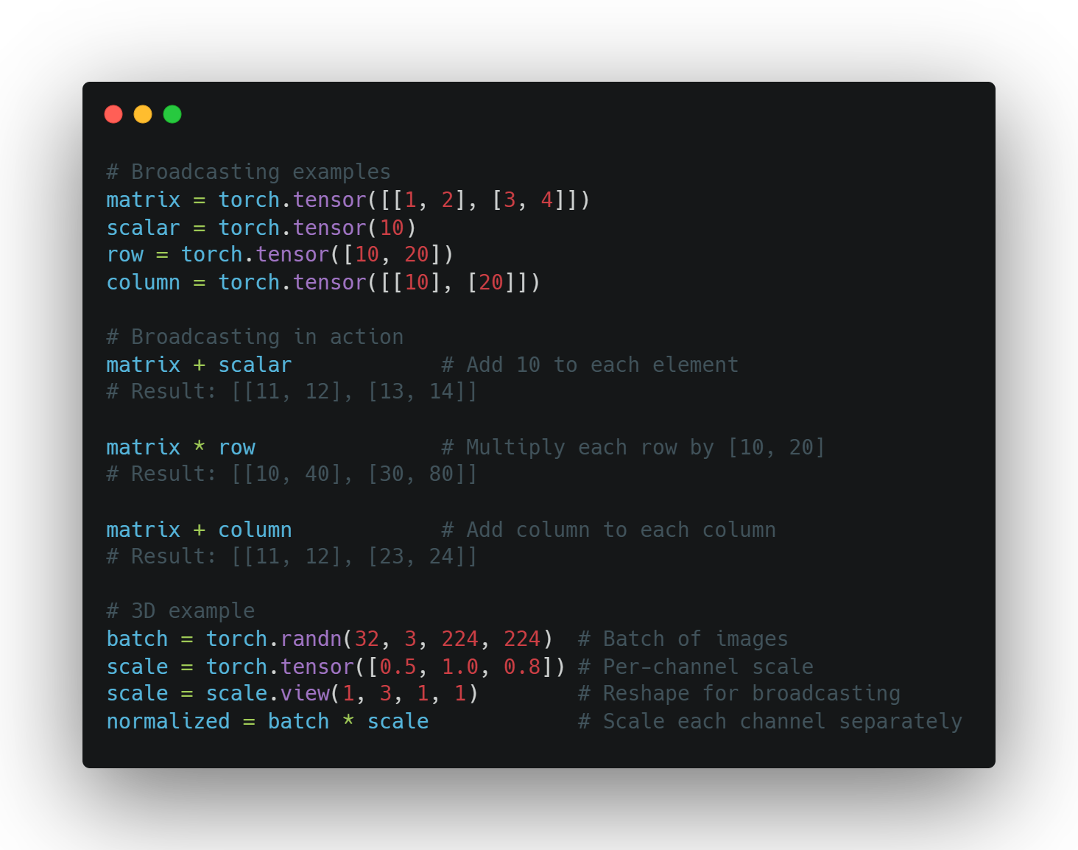
Broadcasting
Working with Different Shapes
Automatic expansion of smaller tensors
Rules follow NumPy broadcasting
Eliminates need for explicit reshaping
Examples:
Add scalar to matrix
Multiply matrix by row/column vector
Scale batches of data
Powerful but requires understanding
SE01
07

Slide 14
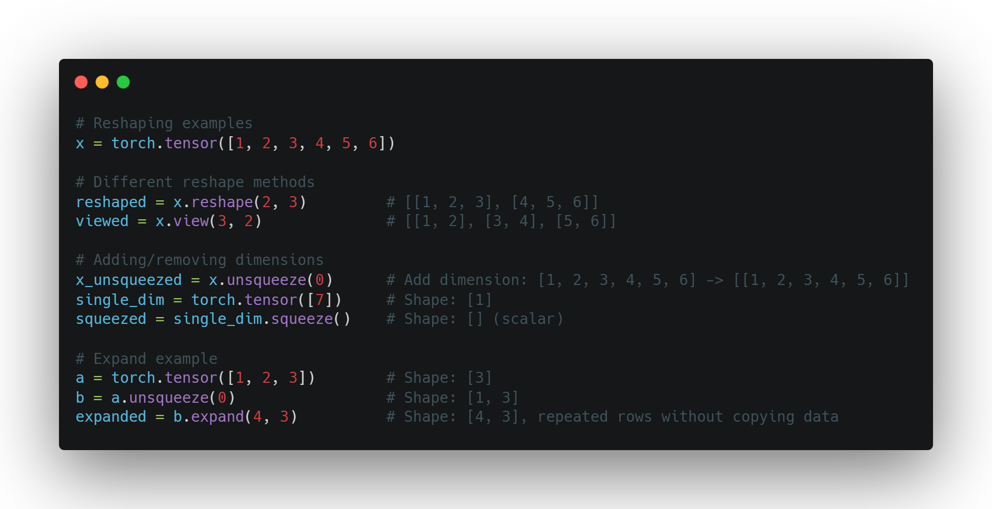
RESHAPING
Changing Tensor Dimensions
reshape() - new shape, possibly new memory
view() - new shape, same memory (must be contiguous)
squeeze() - remove dimensions of size 1
unsqueeze() - add dimension of size 1
expand() - broadcast dimensions without copying
SE01
07

Slide 15
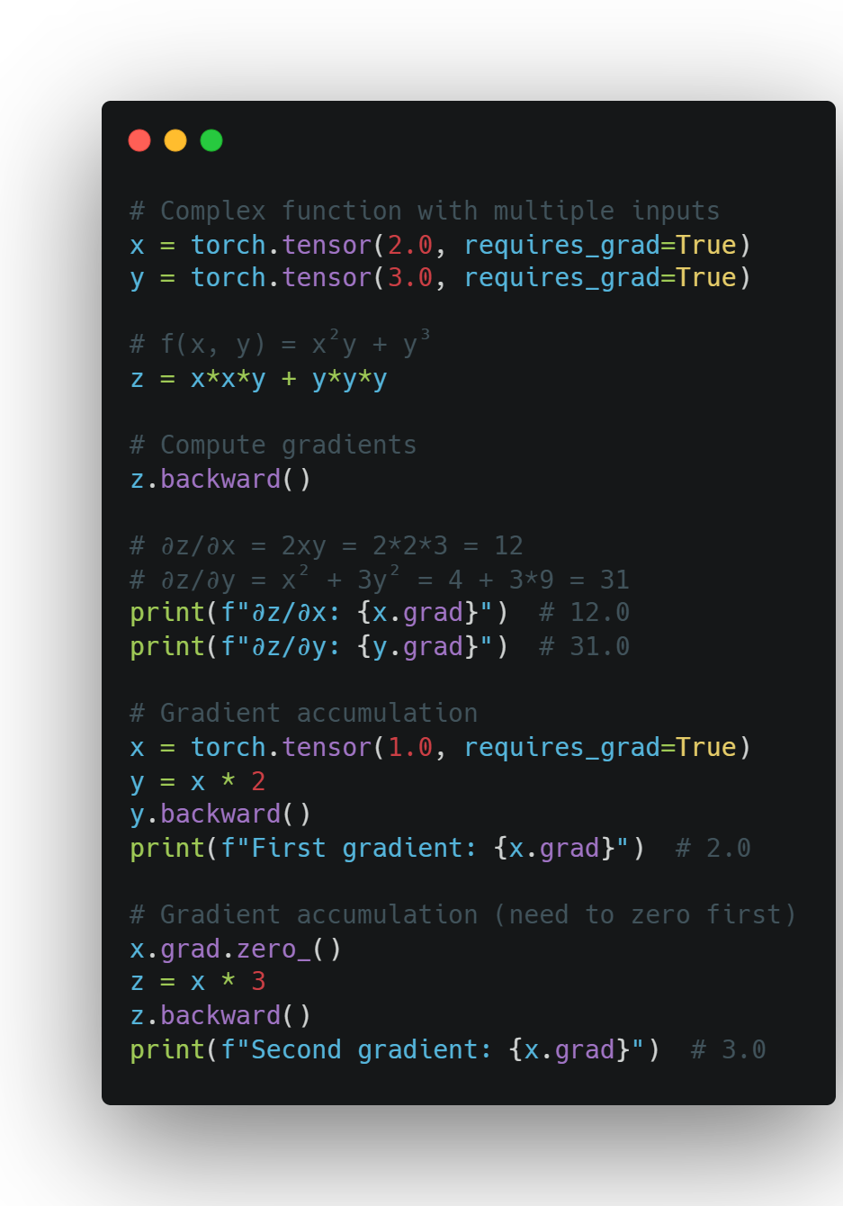
Using autograd
Computing Gradients
Enable tracking with requires_grad=True
Build computation graph through operations
Call backward() to compute gradients
Access gradients via tensor.grad
SE01
07

Slide 16
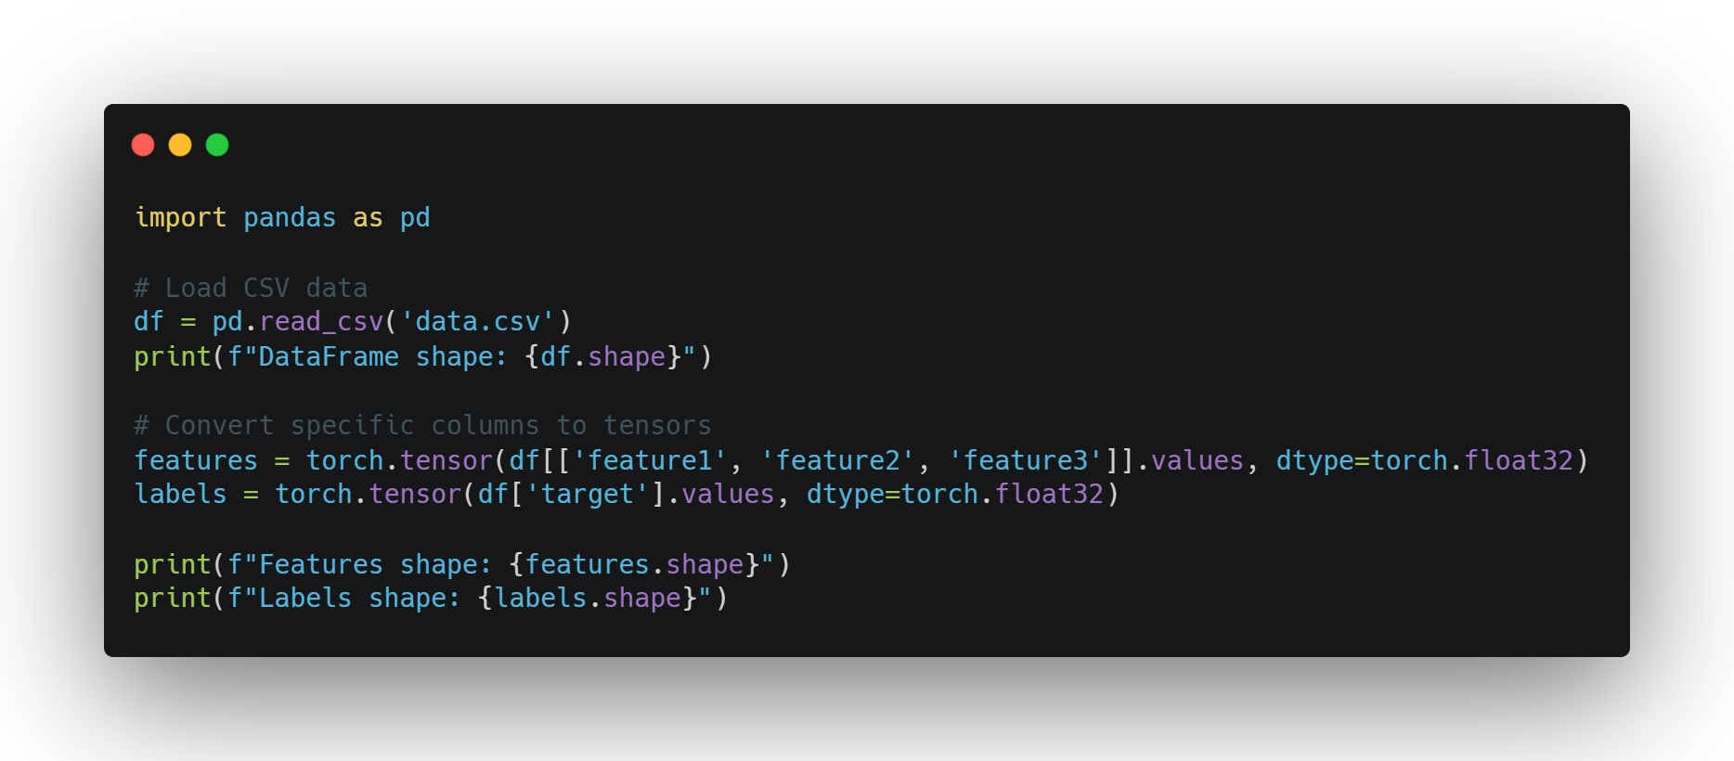
LOADING DATA
From Raw Data to Tensors
Common data sources: CSV, images, text
Using pandas to load structured data
Converting to tensors:
df = pd.read_csv('data.csv')
tensor = torch.tensor(df.values)
DataFrames as an intermediate representation
SE01
07

Slide 17
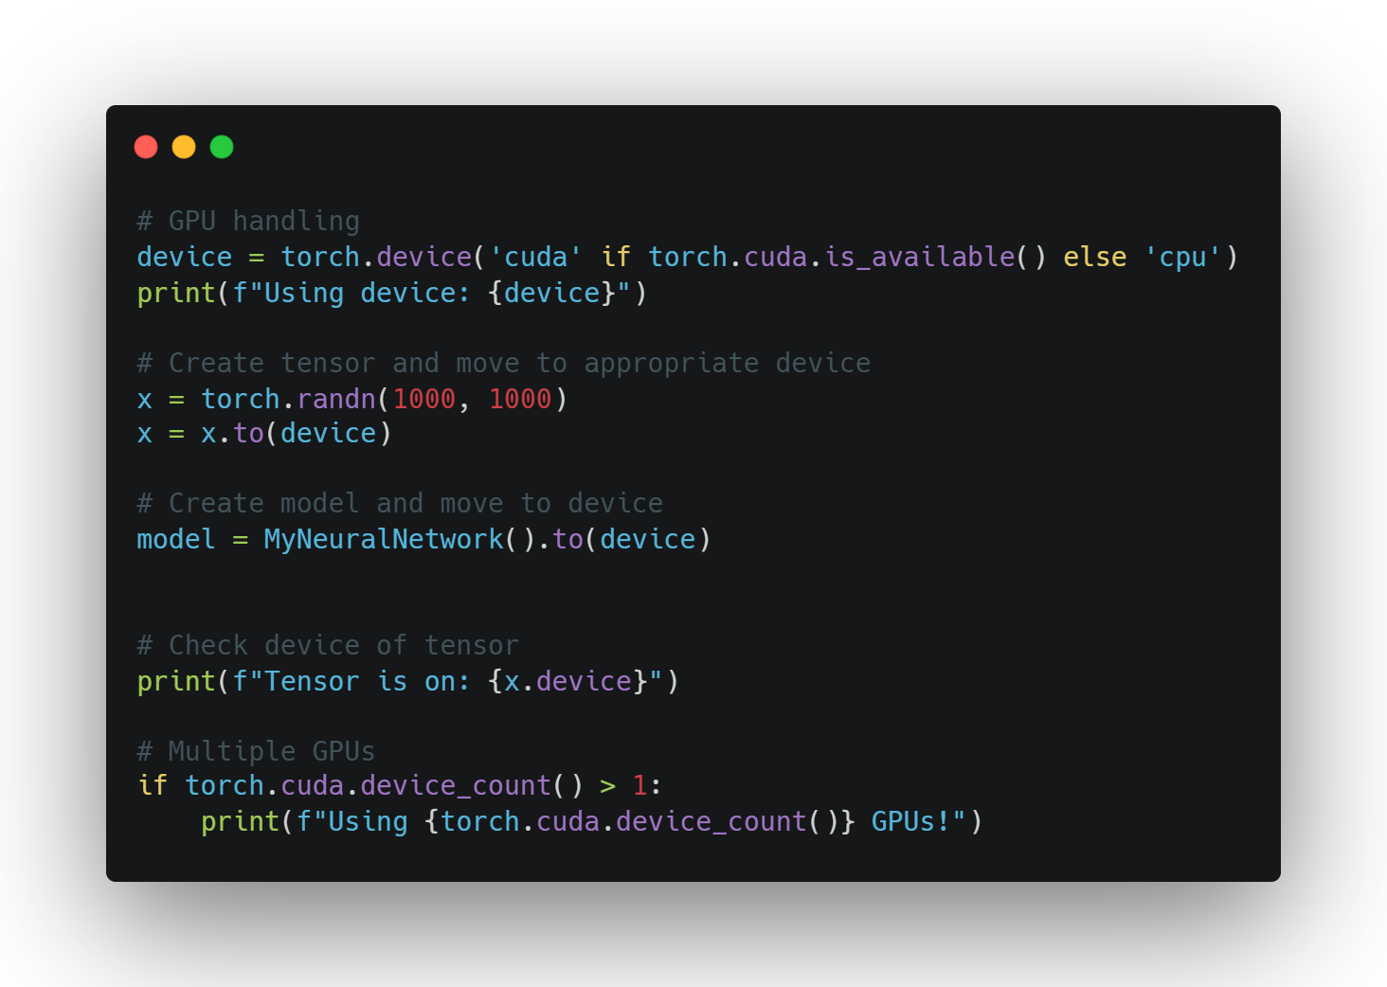
Using
The gpu
Leveraging Hardware
Check availability: torch.cuda.is_available()
Select device: device = torch.device('cuda')
Move tensors to device: tensor = tensor.to(device)
When to use GPU:
Large tensors/datasets
Computationally expensive operations
Deep learning model training
Keep all tensors on same device for efficiency
SE01
07

Slide 18
BEST PRACTICES
Match tensor types before operations
Understand broadcasting rules
Use in-place operations when appropriate
Keep track of your tensor devices
Leverage PyTorch's documentation
Experiment and debug with small examples first

Slide 19
chart

Slide 20
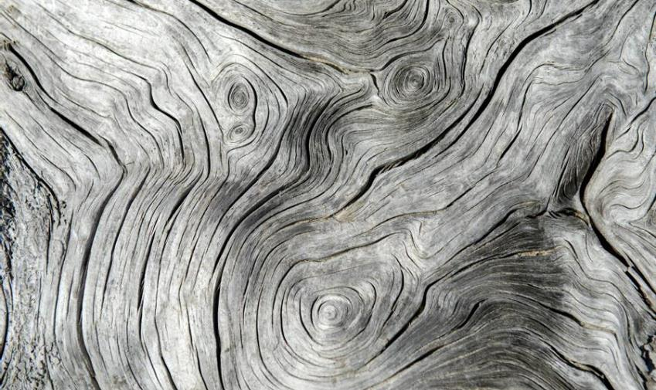
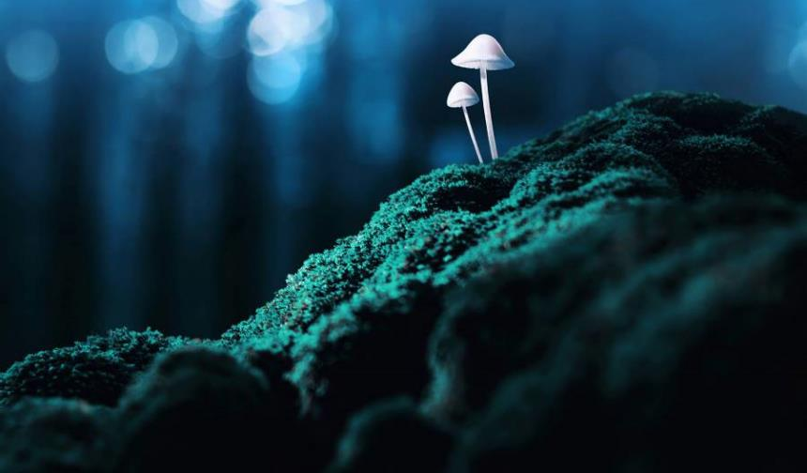
Thank you
Presenter Name | Email | Website

Slide 21
table
 | Category 1 | Category 2 | Category 3 | Category 4
Item 1 | 4.5 | 2.3 | 1.7 | 5
Item 2 | 3.2 | 5.1 | 4.4 | 3
Item 3 | 2.1 | 1.7 | 2.5 | 2.8
Item 4 | 4.5 | 2.2 | 1.7 | 7

Slide 22
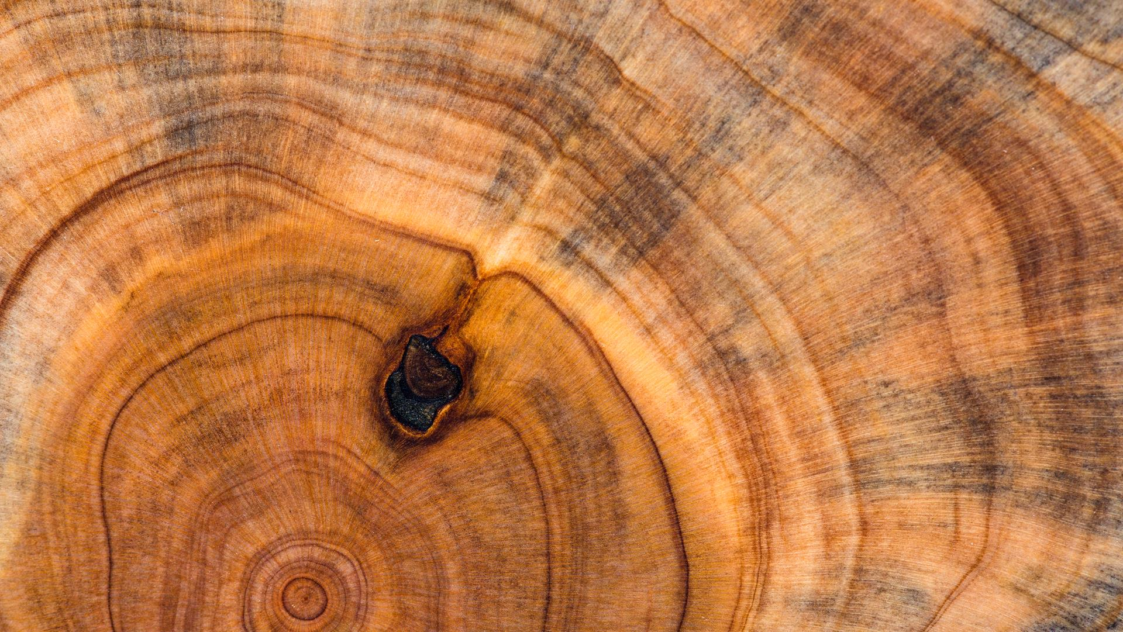
The way to get started is to quit talking and begin doing.
Walt Disney

Slide 23
team
Name Title
Name Title
Name Title
Name Title

Slide 24
timeline
Title
To start a presentation, go to the Slide Show tab, and select From Beginning.
Title
To display Presenter view, in Slide Show view, on the control bar at the bottom left select the three dots, and then Show Presenter View.
Title
During your presentation, the speaker notes are visible on your monitor, but aren't visible to the audience.
Title
The Notes pane is a box that appears below each slide. Tap it to add notes.
Title
If you don’t see the Notes pane or it is completely minimised, click Notes on the task bar across the bottom of the PowerPoint window.

Slide 25
Content
Subtitle
Subtitle
Add text, images, art, and videos.
Add transitions, animations, and motion.
Save to OneDrive, to get to your presentations from your computer, tablet, or phone.
Open the Design Ideas pane for instant slide makeovers.
When we have design ideas, we’ll show them to you right there.

Slide 26
Content
Subtitle
Subtitle
Subtitle
Add text, images, art, and videos.
Add transitions, animations, and motion.
Save to OneDrive, to get to your presentations from your computer, tablet, or phone.
Open the Design Ideas pane for instant slide makeovers.
When we have design ideas, we’ll show them to you right there.
This PowerPoint theme uses its own unique set of colours, fonts and effects to create the overall look and feel of these slides.
PowerPoint has tons of themes to give your presentation just the right personality.

Slide 27
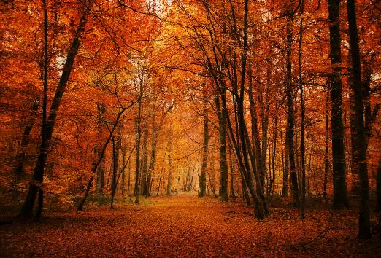
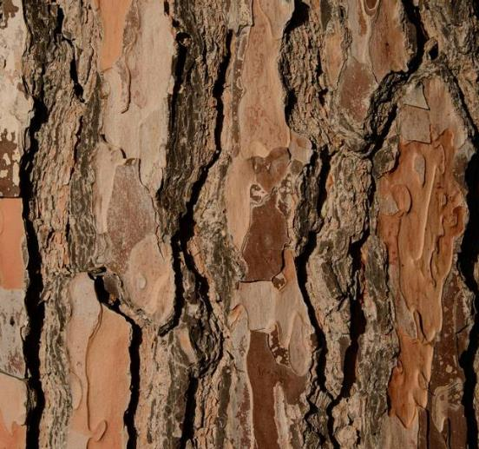

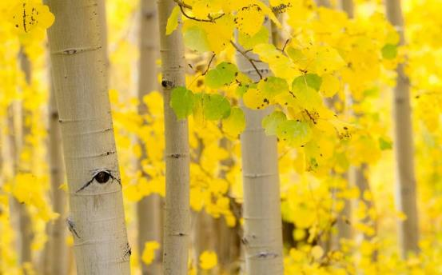
Summary
With PowerPoint, you can create presentations and share your work with others, wherever they are. Type the text you want here to get started. You can also add images, art, and videos on this template. Save to OneDrive and access your presentations from your computer, tablet, or phone. ​

